Slide 1
Project Presentation
IOT based solution for Waste Management & Parking System for future Smart City
Presented By:
PRAJWAL MK 1BY19IS407

Slide 2
CONTENT
Abstract
Introduction
Motivation
Proposed system
Literature Survey
Patent Search
System requirements
System architecture
Module Implementation
Module Demonstration
Results and Discussion
Conclusion
Future Enhancement
Similarity Index
Hyper of the Project Paper
References

Slide 3
ABSTRACT
Internet of things deals with intricate systems that integrates multiple disperse components towards their synergetic use. Here we use system of interconnected smart modules is developed where each and every parameter necessary for a city is monitored and updated to the cloud. Emphasis is given on how sensing and communication technologies of IOT can effectively be used in smart city monitoring.
Basically the system consists of a Arduino microcontroller interfaced with many sensors for making the city smarter. The project aims to bring smartness in five different aspects of any city such as density based traffic monitoring, smart garbage management, city pollution control, intensity based street light monitoring and digital water supply system, traffic control system. Further this project also includes controlling of some parameters like water and light.

Slide 4
INTRODUCTION
Smart city refers to a future city that makes use of upcoming and latest technology.
The wireless sensors are attached to parking area and dustbin. Sensors are then attached to AMC board where each and every necessary parameters for city are monitored and updated to cloud.
The main concept of IOT is machine to machine communication. Internet-based sensor networks have recently been gaining attention.
Sensors are connected to the Internet and the information from the sensors is gathered at a server through the Internet.
Security and manageability of sensor, information transmission connecting to the Internet wirelessly with low cost and high scalability are expected.

Slide 5

PROPOSED SYSTEM
The main categories that define smart cities include the quality of the environment Smart parking system, Garbage management & so on.
To improve the quality of life of people by enabling local area development and harnessing technology, especially technology which leads to the smart city.

Slide 6
LITERATURE SURVEY

Slide 7
SL no | AUTHORS | TITLE | METHODOLOGY | RESULTS/GAPS IDENTIFIED
1 | Andrés Monzón | “Smart City Development: Smart cities concept and challenges bases for the assessment of s ASCIMER (Assessing Smart Cities in the Mediterranean Region | Applying European and International Experience to the Mediterranean Region”. The objective of this first Work Package of research was the development of the Smart City concept and the identification of the main urban development priorities with a special focus on the Mediterranean area. | Low urban institutional capacities. Shortage in access to technology. Economy weaknesses and lack of competitiveness
2 | Juan M. Corchado, Francisco Pinto-Santos | Intelligent Development of Smart Cities: Deepint.net Case Studies | Deepint.net is a platform that has been designed to use Artificial Intelligence models for the analysis of datasets and real-time data sources, all without programming. | Presents an efficient cyber physical platform for the smart management of smart cities.

Slide 8
LITERATURE SURVEY
SL no | AUTHORS | TITLE | METHODOLOGY | RESULTS/GAPS IDENTIFIED
3 | Nguyen Quang Trung | Survey on Automatic devices Segmentation Techniques on IOT devices. | Region growing method. Hybrid segmentation | Some techniques are not robust, considering the characteristics like accuracy and performance.
4 | N.S Raghava | Real-time smart garbage bin mechanism for solid waste management in smart cities | Accesses real-time information of any smart garbage bin deployed across the city and helps to resolve the problem of waste overflow from garbage bins and keep the smart cities clean | Inaccessibility to actual data required, lack of throughput, and late unloading.

Slide 9
LITERATURE SURVEY
SL no | AUTHORS | TITLE | METHODOLOGY | RESULTS/GAPS IDENTIFIED
5 | MaríaE. Cortés-Cediel , Iván Cant, Manuel Pedro Rodríguez | Machine Learning in Wireless Sensor Networks for Smart Cities: A Survey | The small size IoT nodes based on low power Bluetooth (IEEE 802.15.1) standard and wireless sensor networks (WSN) (IEEE 802.15.4) standard are generally used for transmission of data to a remote location using gateways. The WSN based IoT (WSN-IoT) design problems include network coverage and connectivity issues, energy consumption, bandwidth requirement, network lifetime maximization, communication protocols and state of the art infrastructure | The supervised learning algorithms have been most widely used (61%) as compared to reinforcement learning (27%) and unsupervised learning (12%) for smart city applications

Slide 10
PATENT SEARCH
SL NO | PATENT SEARCH | MAJOR FINDINGS
1 | Landfill waste management process By - Stanley M. Kozak | A process for reducing waste material for use with household and other landfill waste material at a landfill waste management site is described. The process reduces the volume of waste material in the landfill site, prevents contamination of the ground soil, allows for the natural breakdown of the organic components of the waste material and allows for the recycling of some or all of the waste material.
2 | Parking space notification device and method. By - Nac Dong Kim | The present invention relates to a parking space notification device and method, and more particularly, to a parking space notification device and method for continuously checking a parking space using leaving or entering information of a vehicle after searching for the parking space.

Slide 11
SYSTEM REQUIREMENTS
Hardware Requirements:
GSM(global system for mobile)
5v Battery
ESP Controller
IR sensors
Wi-Fi
lads
channel relay board
Android smart phone

Slide 12
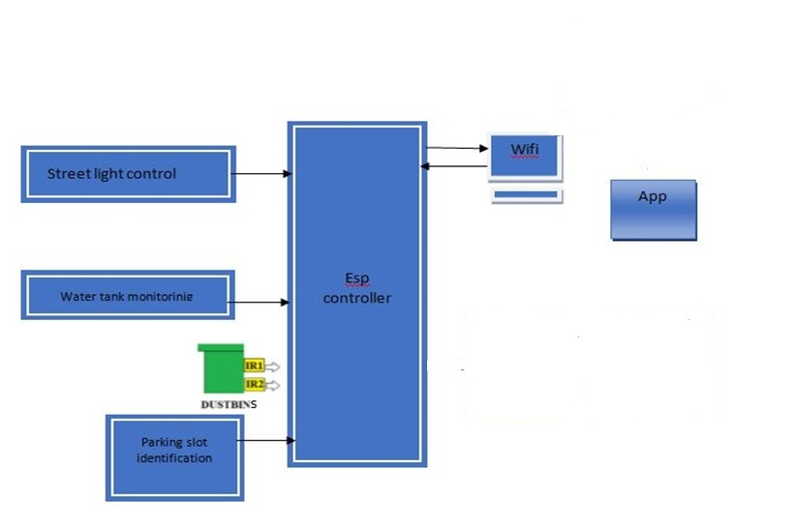
SYSTEM ARCHITECTURE

Slide 13
MODULE IMPLEMENTATION
Dustbin (Waste management)
Parking management.

Slide 14
Basically the system consists of a centralized Microcontroller Arduino connected to internet interfaced with many sensors.
The complete system is controlled and monitored by a multipurpose web app connected to the server.
A set of IR sensors are interfaced with the controller which are in turn mounted on the dust bins so as to monitor the garbage level. Whenever the level reaches to the maximum then information will be passed to the concerned authorities for quick actions

Slide 15
MODULE DEMO
Dustbin module
Dustbin Module, Ultrasonic Detected Waste Quantity Sensor and node MCU microcontroller. Internet is mounted using WIFI module and Notification may be given through app.
Notification displayed on the blynk app with the level of the trash is displayed within the app. We are using node mcu Microcontroller as a controller.
We are sending energy supply to the controller through 9V or 5V DC battery or adapter. Since the controller and sensor require 5V. Ultrasonic sensor is used for submitting the amount of waste and it continuously exams and sends facts to the controller.

Slide 16
Parking Module
The system that will track the entry and exit of vehicles.
And also maintain the listing of vehicles within the parking slot.
It determines if parking slot is full or empty. And also determines the cost of the vehicle according to the time consumption in the parking slot of particular vehicle.
Through the ultra Sonic the level of the dustin is measured & the signal is sent to the ESP controller through that the data sent to the app.

Slide 17
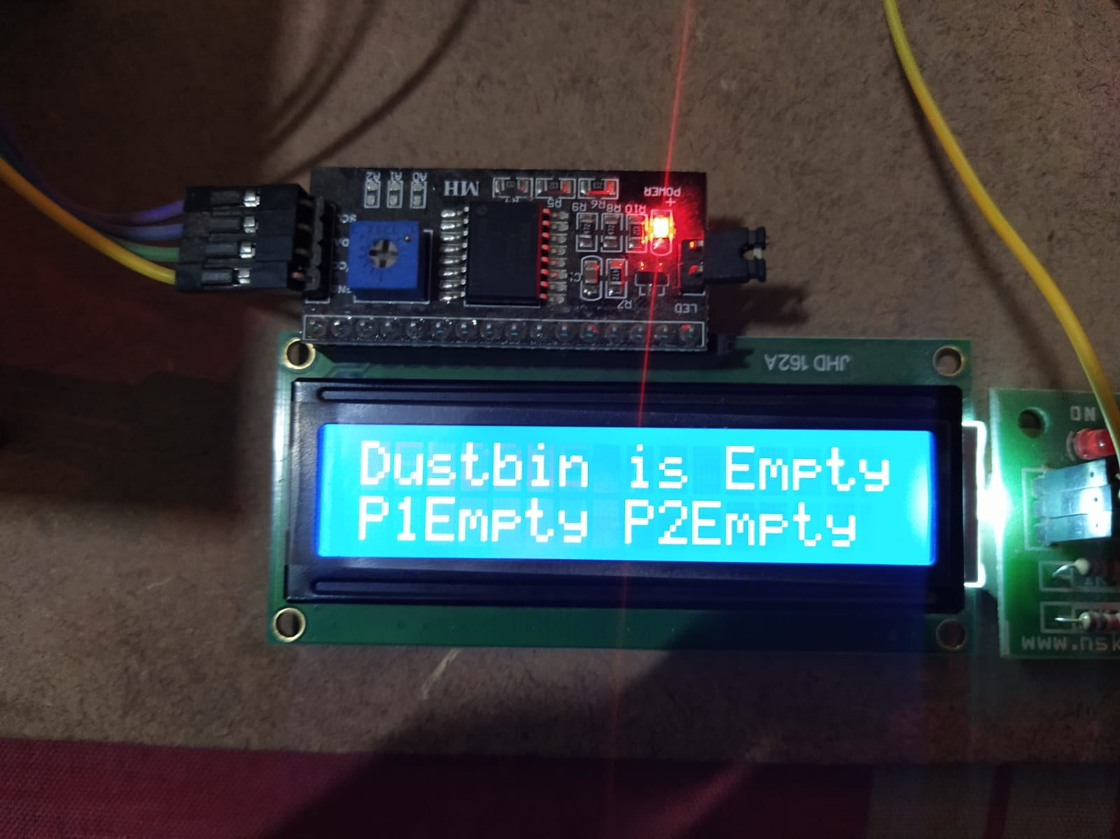
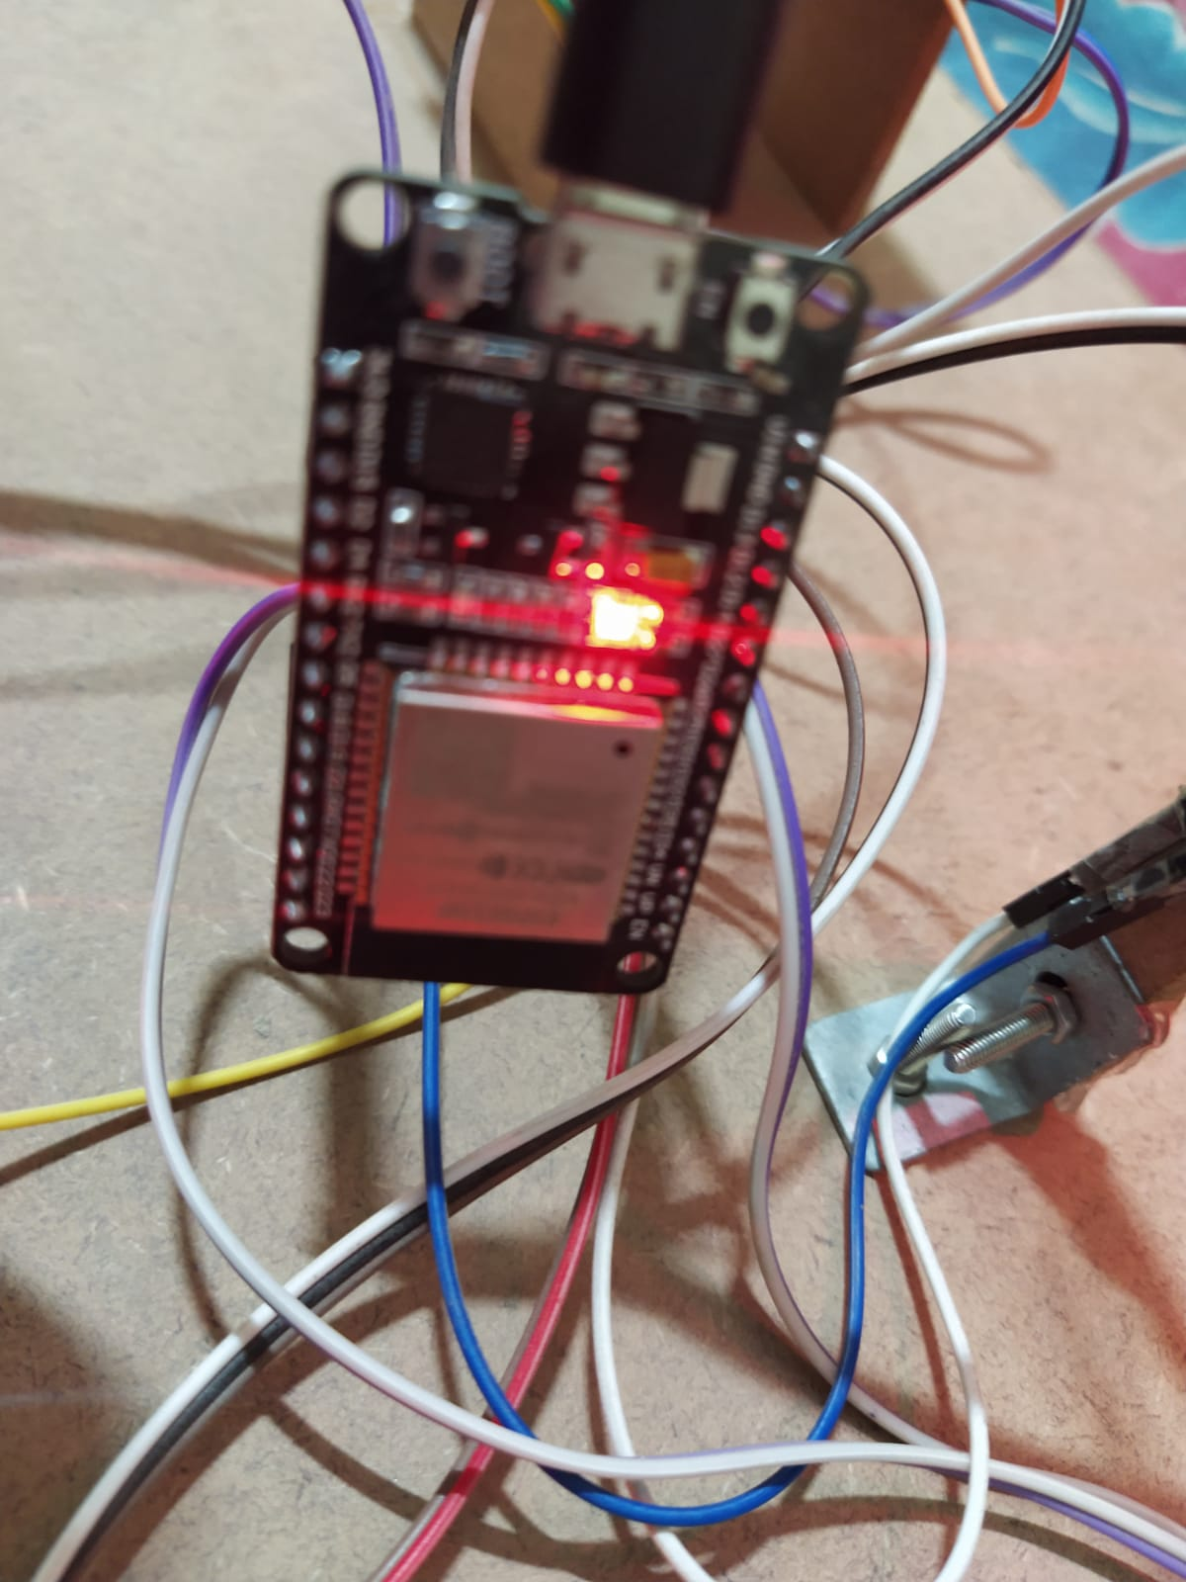
RESULT AND DISCUSSION
Initial Output
This is ESP Controller

Slide 18
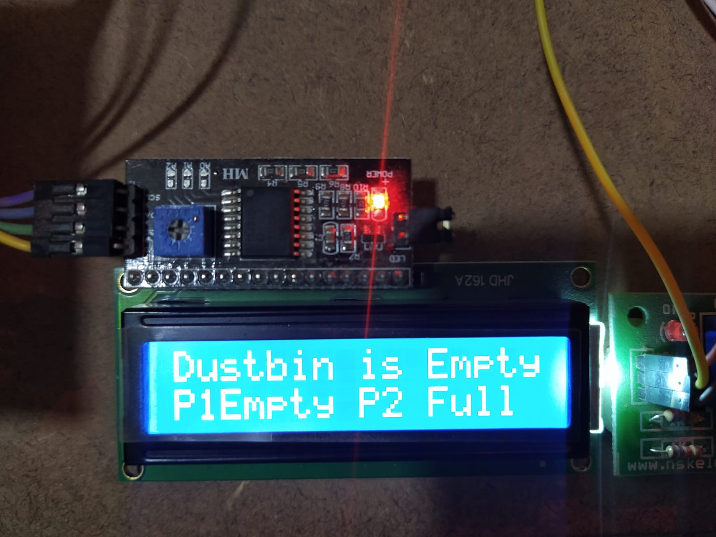
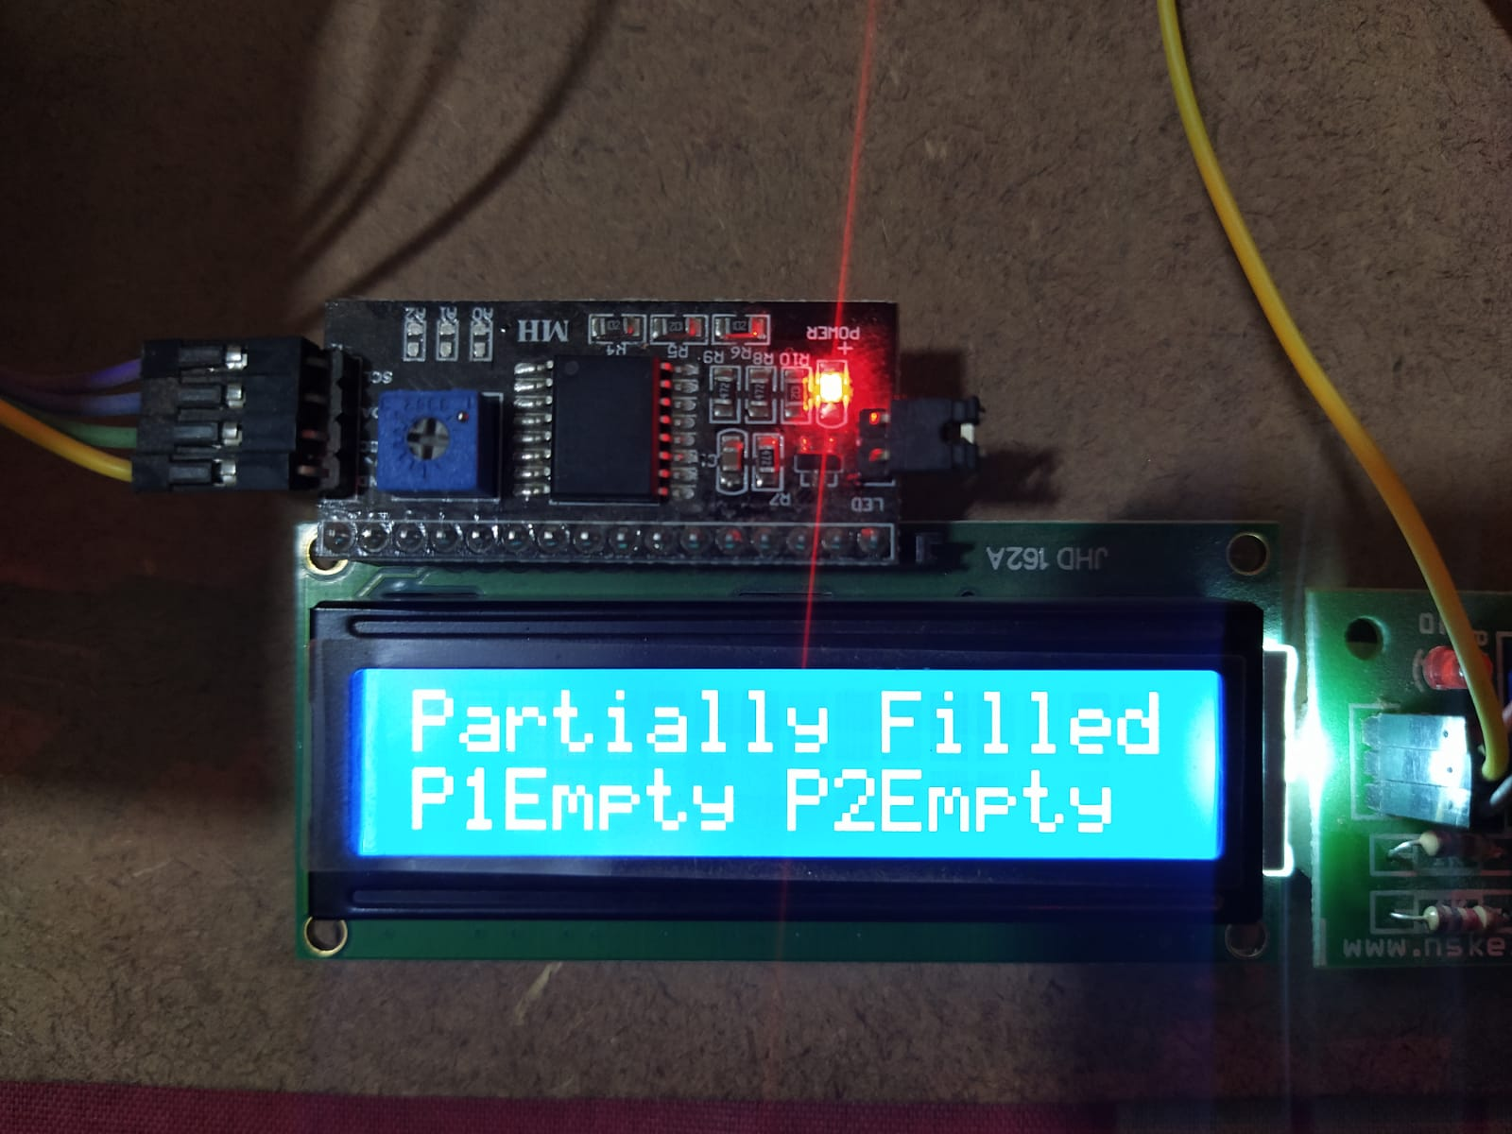
RESULT AND DISCUSSION
Output display of the parking lot
P2 – full whereas P1 - empty
Output display of the
garbage management
Which initially was –
Dustin Bin is Empty

Slide 19
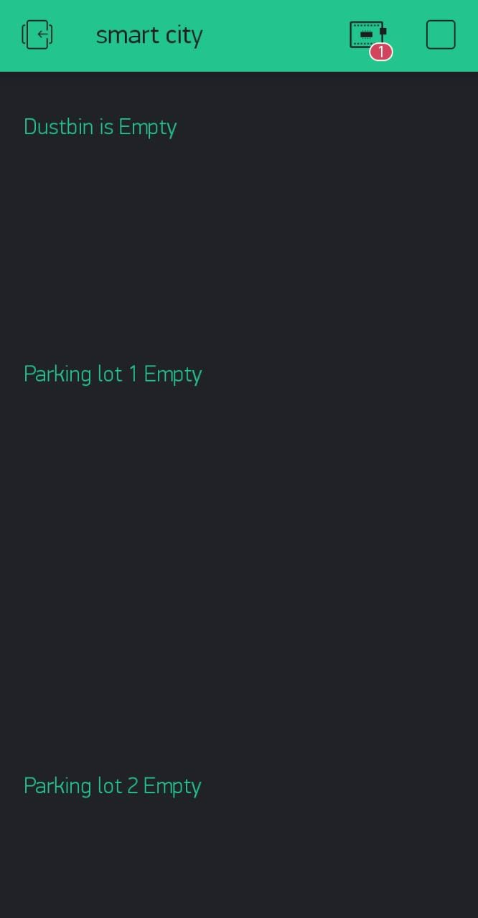
This is the display of the Blink App
Which shows the output of the values
Shown in the Arduino Board

Slide 20
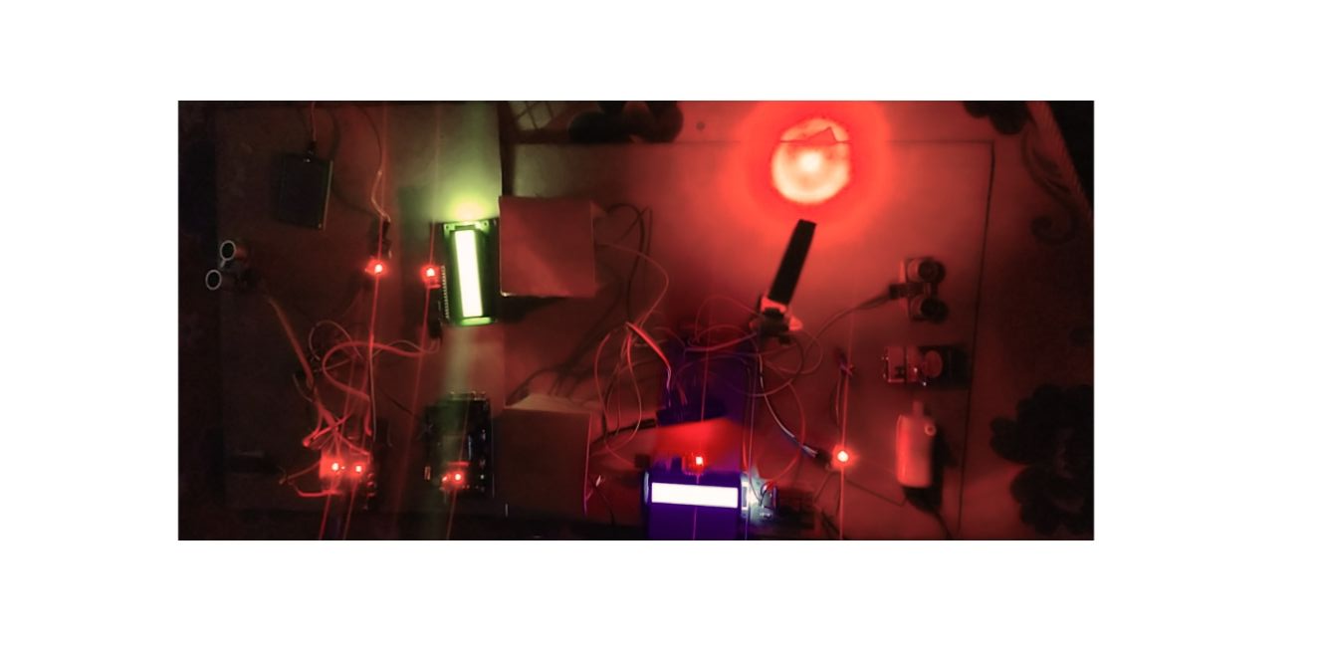
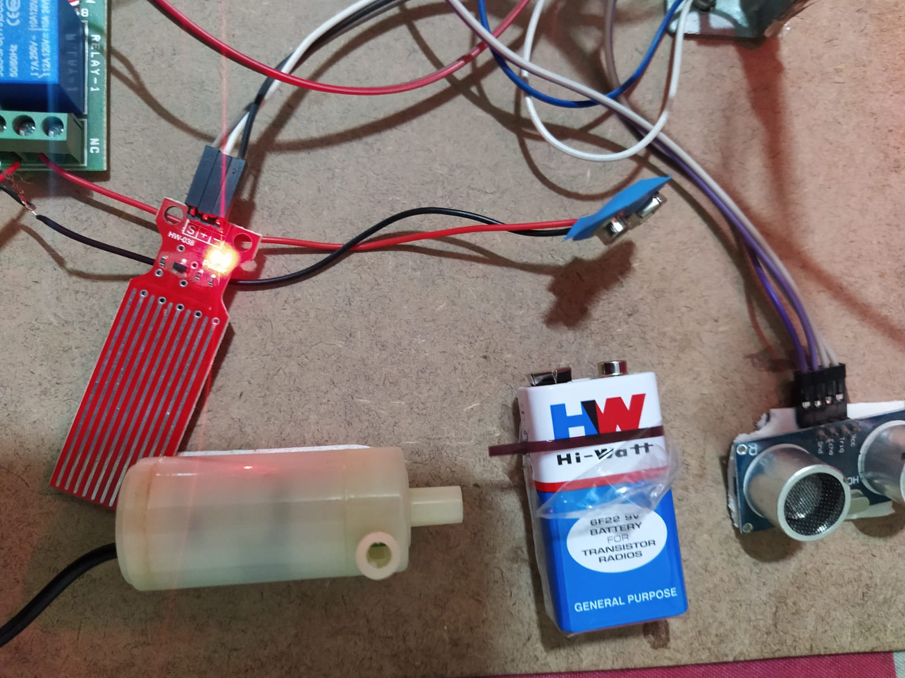
RESULT AND DISCUSSION
These are further implementation

Slide 21
CONCLUSION
IOT is setting off an upsurge of information industry.
IOT is still in its initial stage.
The hardware of a low-cost module used in IOT enabled systems has been designed and the concept for the use of this module for rural development Smart City Monitoring and controlling is done.

Slide 22
FUTURE EHANCEMENT
Controlling the Traffic Signal lights be another feature that we could look in future.
Depending on the amount of traffic in a particular direction, necessary controlling actions could be taken. Also emergency vehicles and VIP convoys can be passed/moved efficiently.
Controlling the street light & smart water management will be the other features that we are implementing in future.
We hope that these advancements can make this system completely robust and totally reliable in all aspects.

Slide 23

HYPER LINKOF PROJECT PAPER

Slide 24
REFERENCES
Nice&SmartCity.Availableonline: http://business.nicecotedazur.org/en/nice-smart-city-2/(accessedon21 August 2020).
http://smartcities.ieee.org/ . There has been a significant activity by IEEE to promote smart cities and to engage cities in using technologies to develop new services. Examples are the core cities of Guadalajara in México, Trento in Italy, Wuxi in China, Casablanca in Morocco, and Kansas City in US. Additionally, this initiative organized the first two international conferences on smart cities successfully held in Guadalajara, México, in 2015 and Trento, Italy, in 2016; the third being planned for Wuxi China in 2017.
SmartCitiesGlobalNetworkDubai(2020).
https://scgn.smartdubai.ae/(accessedon23July2020).https://ieeexplore.ieee.org/document/6740844

Slide 25
REFERENCES
Hollands R. (2019), “Will the real smart city please stand up? Intelligent, progressive or entrepreneurial?”, City: analysis of urban trends, culture, theory, policy, action.
Smart Mobility 2030 in Singapore. Available online: https://www.lta.gov.sg/content/ltagov/en/getting_
Proceedings of the Third International Conference on Smart Systems and Inventive Technology (ICSSIT 2020) IEEE Xplore Part Number: CFP20P17-ART; ISBN: 978-1-7281-5821-1
Corchado, J.M., et al.: Deepint.net: a rapid deployment platform for smart territories. Sensors 21(1), 236 (2021). https://doi.org/10.3390/s21010236

Slide 26
REFERENCES
IEEE Smart Cities initiative:
http://smartcities.ieee.org/
E. Woyke, “Smart cities could be lousy to live in if you have a disability,” MIT Technol. Rev., Jan. 2019. [Online]. Available: https://www.technologyreview. com/s/612712/smart-cities-coule-be-lousy-if-youhave-a-disability/
N. Neyestani, M. Y. Damavandi, M. Shafie-Khah, J. Contreras, and J. P.S. Catalão, "Allocation of plug-in vehicles' parking lots in distribution systems considering network-constrained objectives," IEEE Trans.Power Syst., vol. 30, pp. 2643-2656, 2020.
Butler, L., Yigitcanlar, T., Paz, A.: Smart urban mobility innovations: a comprehensive review and evaluation. IEEE Access 8, 196034–196049 (2020)

Slide 27


